Slide 1
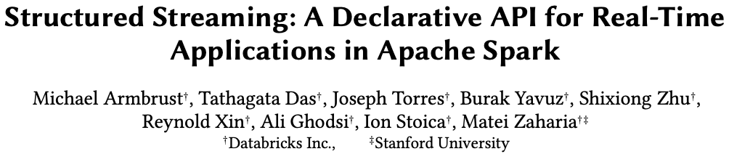
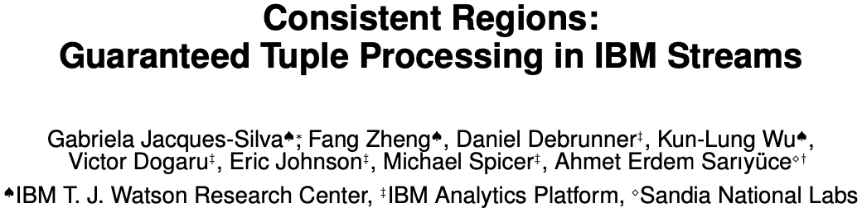
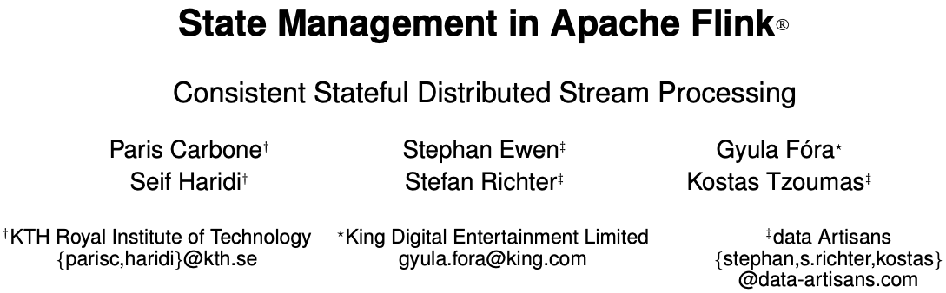
Distributed Systems Reading Group - Session 2 - Klas Segeljakt
Snapshotting Protocols in Distributed Stream Processing Systems
Notes:
Use cases
Explicitly define exactly-once and at-least-once
Order

Slide 2
Outline
Introduction
Flink ➡ IBM Streams ➡ Spark Structured Streaming
Problem statement
System overview
Snapshotting protocol
Discussion (based on results)
Comparison & Conclusion

Slide 3
Introduction

Slide 4
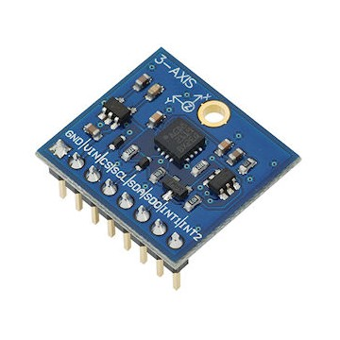



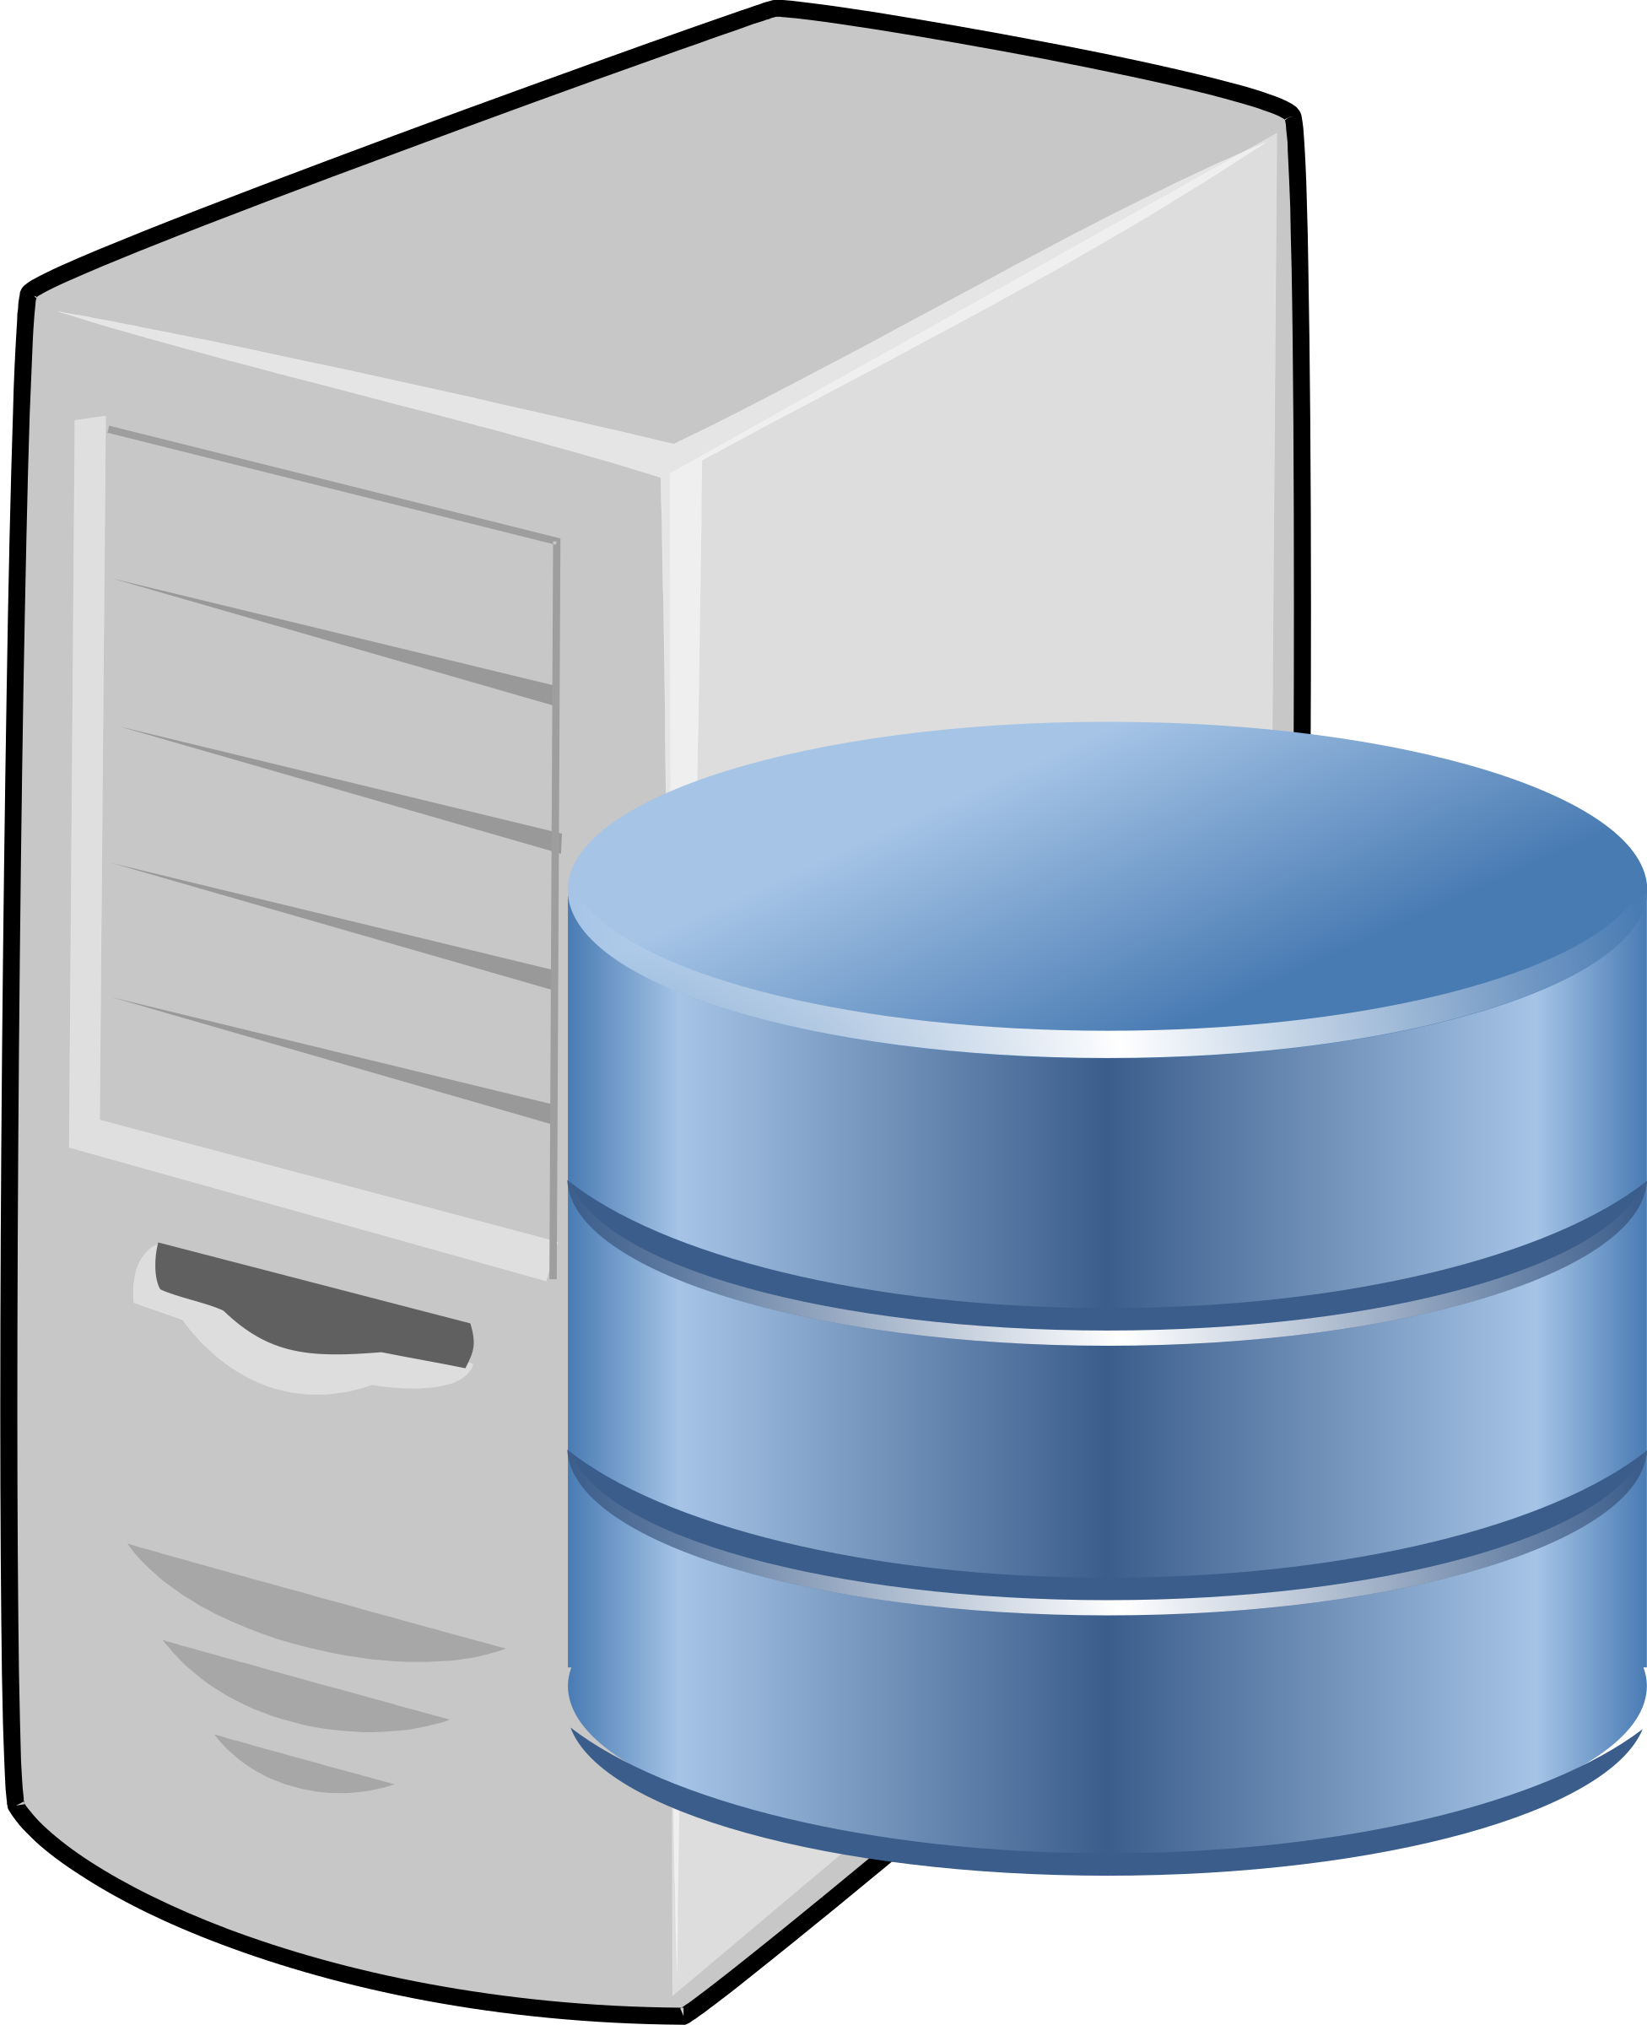
Introduction - Data Stream Processing
Long-Running
Dataflow Task
Execution
Event Logs
Event Logs
Sensor events
Video
Social media
interactions
Transactions
Audio
...
Files
Historic
Data
State
Applications/Services
Slide borrowed from Paris Carbone, LADIS 2018, Asynchronous Epoch Commits

Slide 5
Introduction - Dataflow Graphs
Source
Operator
Sink
Input File
Filter
Stateful Map
Output File
Channel
Element
Local state
+
?
Exactly-once / At-least-once
Processing
Global state =
in-transit elements
+ local state of operators
Reconfiguration
Interactive queries
Consistency
Guarantees
Exactly-once / At-least-once
Delivery
Notes:
Consistency guarantees:
Exactly-once delivery
Exactly-once processing
Should Operator be Process?
Terminology
Failure recovery
Page 46
Consistent

Slide 6
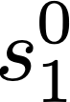
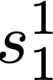
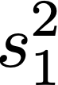
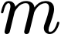
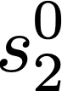
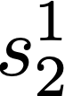
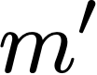
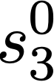
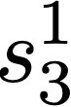
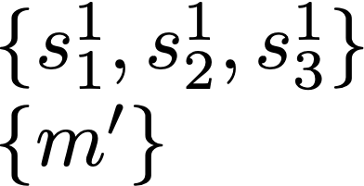
Introduction - Snapshotting Protocols
Snapshotting Protocols: Distributed Algorithms that implement distributed cuts
in a system execution to yield a global state
p1
p1
p2
p2
p3
p3
Snapshot of C
C
C’
Consistent cut
(Satisfies causality)
Inconsistent cut
(Violates causality)
Slide borrowed from Paris Carbone, LADIS 2018, Asynchronous Epoch Commits

Slide 7

Validity Explained
System
Possible Execution
p1
p1
p2
m
p2
m’
p3
p3
C’
Valid: No causality violations in C’
(C’ is a consistent cut)

Slide 8
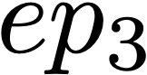
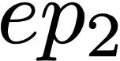
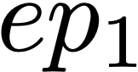
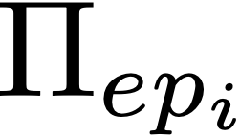
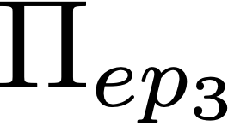
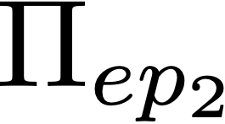
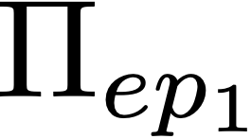
Epoch-Based Stream Execution
Logged Input Streams
volatile
state
Committed Output Streams
Stable
Storage
Committed
System States

Slide 9
Synchronous Epoch Commits
Coordinator
Tasks
computation time
prepare ep1
idle time
ep1 prepared
commit ep1
Stable
Storage
ep1 committed
prepare ep2
ep2 prepared

Slide 10
Apache Flink

Slide 11
Flink - Problem statement
Stream processing systems lack state abstractions
State is either handled externally by the user (e.g. DBMS) ...
Maintenance & Transactional costs
Operational challenges (scaling, failure-recovery, patches)
Or handled by micro-batching ➡ Processing latency
Question: Can state management be interleaved with processing?
Solution: Distributed Snapshots

Slide 12
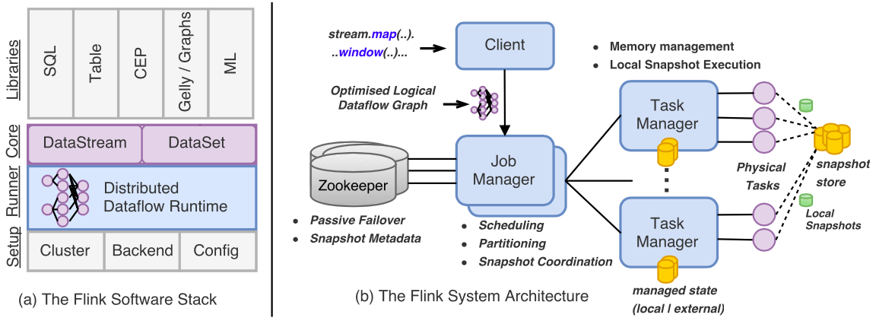
Flink - System Overview
How do snapshots work?
Schedule-once policy
Notes:
JobManager = Master-node
JobManager Single-point-of-failure => We employ a passive-standby high availability scheme where configured standby nodes can take undertake the coordination role of the failed master node via distributed leader election
Finally, pipeline deployments in Flink are highly available, thus, tolerating even master failures via leader election and passive failover in Zookeeper
Local state backend = Distributed file system inside the cluster?
Data parallel key groups (per task?)

Slide 13

Recap: Chandy-Lamport - Consistent Snapshots
On first marker (atomic)
Capture internal state
Start recording other input channels
Forward marker
Finished if no more channels are being recorded
Flink's snapshots are related to the Chandy-Lamport protocol
Both capture the global state of a distributed system
Assumptions
Reliable FIFO ordered channels
Strongly connected graph
Single initiating process
M
Before marker
(Captured in snapshot)
On secondary markers (atomic)
Stop recording the receiving input channel
Finished if no more channels are being recorded
After Marker
(Not captured in snapshot)
P1
M
P1
P2
P2
= Before marker
S1
M
S2
= After marker
M
Snapshot
Recording
M
P3
P4
P3
P4
S3
Recording
S4
M
Finished!
Intuition:
Liveness (Termination)?
Safety (Causal validity)?
Markers eventually reach all processes, from all inputs.
State is persisted before elements are recorded.
Can the assumptions be modified
to fit the stream-processing use-case?
Notes:
Explain what a marker is needed for

Slide 14
Flink - Distributed Snapshots
Chandy-Lamport - Assumptions
Reliable FIFO ordered channels
Strongly connected graph
Single initiating process
Apache Flink - Assumptions
Reliable FIFO ordered channels
Weakly connected graph
Channels can be blocked/unblocked by tasks
Sources are replayable
Notes:
Sources keep offsets
Epochs are synchronisation points

Slide 15
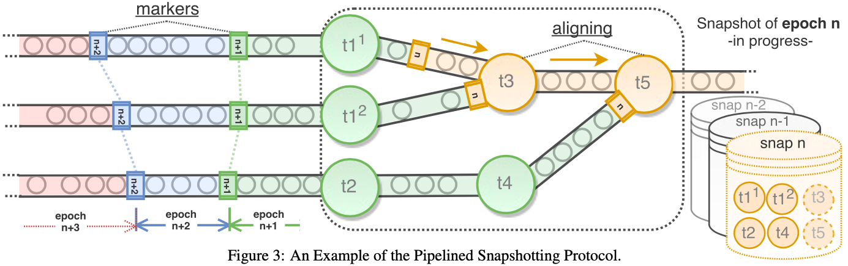
Flink - Distributed Snapshots
1. Inject markers
Begin snapshots by injecting markers at the
sources, that cut the stream into epochs.
2. Alignment
When an operator receives a marker,
the receiving channel is blocked.
3. Commit
Once an operator has received markers
on all channels, it forwards the marker,
persists its local state, and unblocks.
On failure
Rollback
Replay
Idea: Snapshot n reflects the
global state after processing epoch n
t6
Optimizations:
Incremental snapshots
Asynchronous compactions
What about cyclic graphs?
Exactly-once delivery:
Idempotent sinks
Transactional sinks
Notes:
Alignment, blocked?
RocksDB
Sources keep offsets
Epochs are synchronisation points
Spill in-transit records to disk

Slide 16
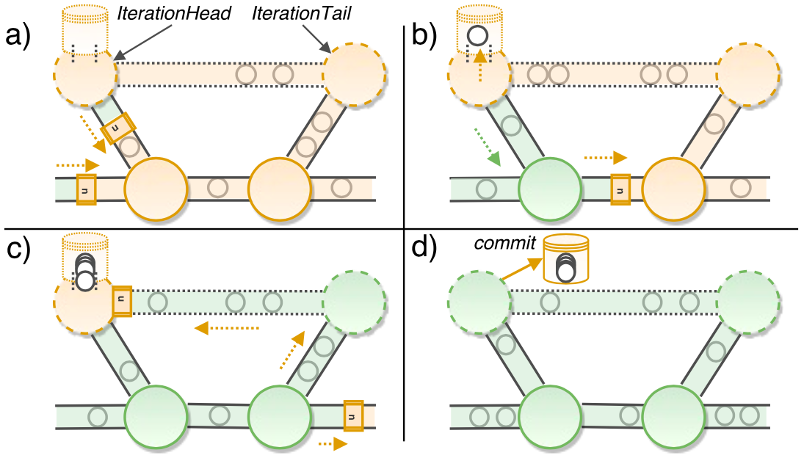
Flink - Distributed Snapshots
1. When cycles are present,
Flink falls back to Chandy Lamport
3. Elements from the tail of the
cycle are recorded.
Recording
2. Markers are injected
at the head of the cycle.

Slide 17
Flink - Discussion
Q: What affects snapshotting latency?
A: Alignment introduces latency. Global state size is not a factor.
Q: What affects the alignment time?
A: The number of input channels (determined by shuffles & data parallelism).

Slide 18
IBM-Streams

Slide 19
IBM-Streams - Problem statement
Snapshots impose overhead
What if processing guarantees are only necessary for some operators?
Solution? Create a stream processing language for more fine-grained control
Consistency required
Apache
Flink
Consistency required
IBM
Streams
Consistency not required

Slide 20
IBM Streams - System Overview
Operator Toolkit
(Pre-constructed operators)
High-level API
Map, filter, e.g.
Operator-construction API
Low-level API
Supports multi-threaded operators
Stream processing language (SPL)
C++
Java
Language
Code generation, runtime hooks
SPL Runtime
Runtime
IBM Streams Platform
Platform
Failure recovery
Consistent region controller detects error
Stop submission of new tuples
Propagate ResetMarkers
When other receive markers on all channels
Fetch state from backend store
Additional features:
Operators can be multi-threaded
Use semaphores to synchronise local state snapshots with element submissions

Slide 21
IBM Streams - Consistent Regions
Snapshots only occur inside consistent regions
Consistent regions are formed by annotating operators:
@consistent starts a consistent region
@autonomous ends a consistent region
Consistent sources
replay tuples
Exactly-once
processing
@consistent
Op
Sink
Op
Op
Sink
Op
Sink
Sink
Source
Source
@consistent
Op
Op
Op
Source
Op
Source
@autonomous
@autonomous
Source
Op
Op
Op
Sink
Source
Op
Op
Op
Sink
Sink
Sink
At-most-once
processing
At-least-once
processing
Autonomous sources
do not replay tuples
Data ports and control ports
Notes:
The compiler computes the reachability graph
Merge
Default
Trigger => How to start the establishment of a consistent state (periodic or operator-driven)
period
drainTimeout
resetTimeout
maxConsecutiveResetAttempts

Slide 22
IBM Streams - Input ports
Problem: As in Flink, feedback loops must be considered when snapshotting
Solution: Model feedback loops explicitly
Channels connect with operators through input ports and output ports
Input ports are either ...
Data ports, that may both mutate state and output new elements
Control ports, that may only mutate state
Feedback loop
data
data
control

Slide 23
IBM Streams - Snapshotting Protocol
@consistent
After receiving a DrainMarker on every consistent data port-channel:
Drain in-flight elements (buffers etc.).
Block elements to outgoing channels
Forward DrainMarkers
Wait for DrainMarkers on all consistent control port-channels.
Checkpoint local state
Notify termination to Consistent Region Controller
After receiving a snapshot notification:
Drain in-flight elements (buffers etc.)
Block elements to outgoing channels
Checkpoint local state
Forward DrainMarkers
Drain
Marker
Blocked
Finished
@consistent
Consistent
Region
Controller
Snap. Not.
Snap. Not.
Drain
Marker
Finished
Finished
Finished
Finished
data
data
data
data
control
Finished
@autonomous
Snapshot
Snapshot
Notification
Autonomous input ports are
blocked while snapshotting.
Failure recovery follows a similar idea:
Pause processing (instead of drain)
Rollback state (instead of checkpoint)
Forward ResetMarkers
Finally, start replaying elements
Notes:
Drain: Empty the queues

Slide 24
IBM Streams - Discussion
Q: What are the weaknesses of the snapshotting protocol?
A: Dataflow is blocked until sinks receive drain markers on all channels.
A: State checkpoints are currently synchronous.

Slide 25
Apache Spark
Structured Streaming
(Version 2.3.0)

Slide 26
Spark Structured Streaming - Problem Statement
API
Challenges
Integration
Challenges
Reusing programs for batch data is often not possible
Users must write incrementally executing code: What vs How
Streaming programs don't run in isolation
Must support interactive queries & joins with batch data
Solution: Unified API & Runtime for Stream & Batch
Operational
Challenges
Cost & Performance
Challenges
Streaming systems are distributed
Must handle failures, migration, graceful shutdown, code updates, stragglers, monitoring, ...
Streaming systems run 24/7
Must support dynamic rescaling
Favour throughput over latency
Notes:
Throughput > Latency, as data is already delayed

Slide 27
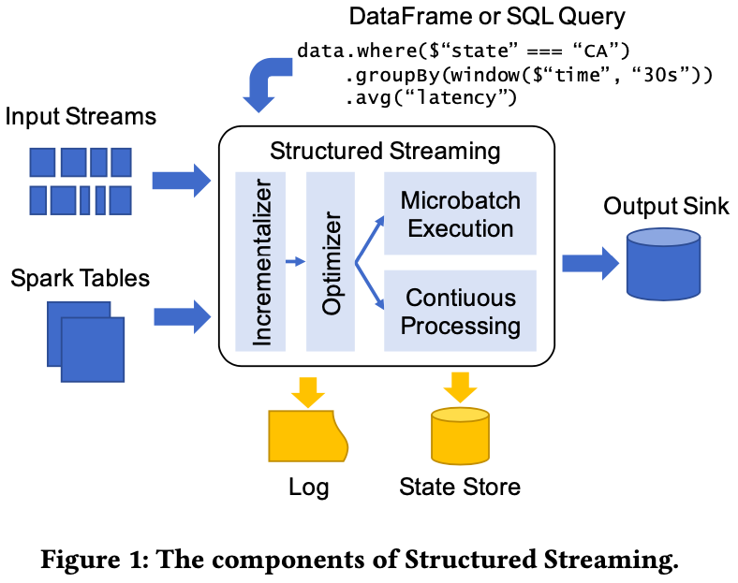
Spark Structured Streaming
Microbatch execution
≈ Spark Streaming
Analysis
Check types, attributes, incrementalisation
Incrementaliser
Reuses catalyst
Optimizer
Catalyst
Continuous processing

Slide 28
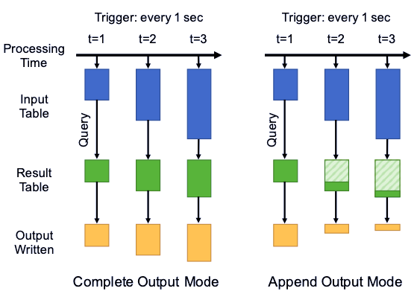
Spark Structured Streaming - System Overview
API additions
Event-time
Stateful operators
Triggers (When to output)
(Replayable)
(Idempotent)
Output modes
(What to output)
Complete
Append
Update
Notes:
Adaptively batch - catch up
Append works for monotonic outputs
Analysis => Incrementalizer => Optimizer
Incrementalization = Not having to recompute everything
Incrementalization is restricted
Short running vs long running tasks
Minibatch for scaling up and catching up with rollback recovery
"Run-once" triggers for saving money
Is epoch size determined by triggers? probably

Slide 29
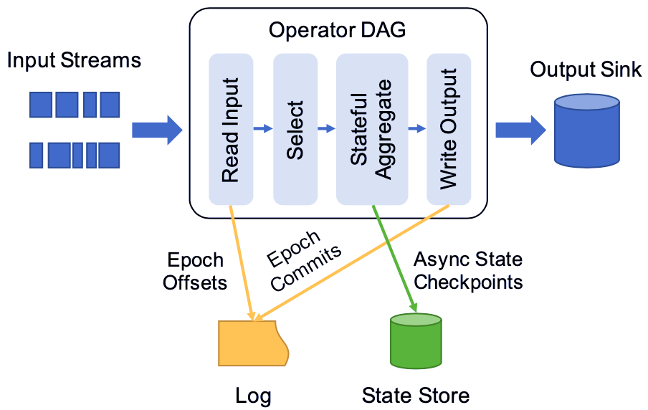
Spark - Checkpointing
Input operators log start and end offsets of epochs
Stateful operators periodically checkpoint their local state (along with the epoch id)
Output operators log epochs committed to sinks
On recovery,
Roll-back to an old state
Re-construct the state into what it was before the last uncommitted epoch, by replaying committed epochs
Replay, starting from the uncommitted epoch
Difference:
Flink's snapshots are triggered by markers
Spark's checkpoints are triggered periodically ➡ Might need to replay committed epochs
Notes:
Might need to roll back more than just uncommitted epochs, as state is not persisted synchronously with commits

Slide 30
Spark Structured Streaming - Checkpointing
Operator DAG
Failure Recovery
Replayable
Source
Read Input
Select
Stateful
Aggregate
Write Output
Idempotent
Sink
Epoch Offset
(start, end)
Async Periodic
Checkpoint
(stateepoch-id)
Epoch Commit
(epoch-id)
Spark's master node divides
the input into epochs
1. Roll back to the most recent
checkpoint
2. Replay epochs committed
after the checkpoint (while disabling outputs to sink)
staten-4
staten-8
staten-12
staten-16
...
committed epoch n-1
committed epoch n-2
committed epoch n-3
committed epoch n-4
...
read epoch n with offset (140, 160)
read epoch n-1 with offset (120, 140)
read epoch n-2 with offset (100, 120)
read epoch n-3 with offset (80, 100)
read epoch n-4 with offset (60, 80)
...
read epoch n with offset (140, 160)
read epoch n-1 with offset (120, 140)
read epoch n-2 with offset (100, 120)
read epoch n-3 with offset (80, 100)
read epoch n-4 with offset (60, 80)
...
3. Replay the uncommitted epoch
State
Store
Log
Minibatch Execution:
Each epoch is executed by multiple (short-running) tasks
Continuous Processing:
Each (long-running) task reads from one partition and executes multiple epochs (but no shuffles are allowed)
Notes:
One checkpoint per fifth epoch

Slide 31
Spark Structured Streaming - Discussion
Q: What are the benefits of each execution mode?
A: Microbatch Execution for throughput (load balancing).
A: Continuous Processing for latency (less scheduling).

Slide 32
State checkpoint
Input operators log start and end offsets of epochs
Stateful operators checkpoint their state every Nth epoch (along with the epoch-id)
Output operators log committed epochs
On recovery,
Roll-back to an old state
Re-construct the state into what it was before the last uncommitted epoch, by replaying committed epochs
Replay, starting from the uncommitted epoch
Source
Input Operator
Stateful
Operator
Output Operator
Sink
Epoch Offset
(start, end)
Epoch Commit
(epoch-id)
Async Periodic Checkpoint
(stateepoch-id)
Epochs
committed
after checkpoint
Most
Recent
Checkpoint
Log
State
Store
staten-4
staten-8
staten-12
staten-16
...
Epochs
committed
after checkpoint
epoch n-1 committed
epoch n-2 committed
epoch n-3 committed
epoch n-4 committed
...
epoch n has offset (140, 160)
epoch n-1 has offset (120, 140)
epoch n-2 has offset (100, 120)
epoch n-3 has offset (80, 100)
epoch n-4 has offset (60, 80)
...
Notes:
One checkpoint per fifth epoch

Slide 33
Spark - Execution Model
 | Minibatch Execution | Continuous Processing
Pros | Dynamic load balancing, Fine-grained fault recovery, Straggler mitigation, Rescaling, Scale and throughput | Low latency, failure recovery
Cons | Higher minimum latency | No protection against stragglers and node imbalances

Slide 34
Comparison & Conclusion

Slide 35
Comparison
 | Execution Model? | Queryable State? | Snapshot Granularity? | Cyclic Snapshots Method? | Exactly-once Delivery Requirements? | Additional Properties?
Flink | Continuous | Yes | Global | Chandy Lamport | Idempotent or Transactional sinks | Incremental snapshot Async. compaction Channel blocking Channel recording
IBM-Streams | Continuous | N/A | Region | Data & Control Ports (Only feedback loops) | Retractable sinks | Incremental snapshot Channel blocking Sync. state transfer
Spark Structured Streaming | Continuous & Minibatch | Yes | Global | N/A | Idempotent sinks | Incremental snapshot Async. state transfer ???

Slide 36
State Backend |  | Exactly-once processing | Interface | Dataflow graph | Operational features
Pluggable |  | Alignment | API | Weakly connected, cyclic
Pluggable |  |  | API | Weakly connected | Manual rollback, minibatch recovery
Pluggable |  |  | Language | Weakly connected, cyclic | multi-threaded operators

Slide 37
Results (Takeaways)
Flink claims

Slide 38
Comparison
 | State Tracking | State Granularity | Type Requirements | Snapshot properties | State Backend | Exactly-once delivery | Exactly-once processing | API | Dataflow graph | Operational features
Flink | Snapshots | Global, marker-based | Must use builtin types | Lazy, asynchronous, managed state | Pluggable (Local or external) | Idempotent or Transactional sinks, replay | Alignment | Streaming, Batch | Weakly connected, cyclic
Spark Structured Streaming | Minibatch or Snapshots | Global, periodic | Type is serializable |  | Pluggable (Local or external) | Idempotent sinks, replay |  | Streaming, Batch, incrementalization | Weakly connected | Manual rollback, minibatch recovery
IBM-Streams | Snapshots | Subgraph |  | Language-level abstractions | External | replay |  | Streaming | Weakly connected, cyclic | multi-threaded operators

Slide 39
Predictions / Future Work
Past
Present
Future
In-house
Data center
Cloud platforms
+
Edge devices
5G
Dataflow
Execution
Future work for snapshotting protocols:
Specialise towards throughput/latency/recovery time/space/...
Take data into consideration
Optimise code inside operators for snapshotting
Hardware acceleration, e.g. Remote Direct Memory Access (RDMA)
Clean
Train Serve
Credits to Adam Hasselberg for predictions
Buy your own hardware
Secure but hard to maintain
Centralised architecture
Dedicated cloud platforms
Microservices
Distributed architecture
Elasticity
"Internet of things"
Planet-wide scale-out
Decentralised architecture
"
"
Stateful channels?
Notes:
Maybe some data elements are more important than others

Slide 40
END

Slide 41
Apache Spark - Problem Statement
API Challenges
Streaming systems must not expose low-level details, for example:
Physical execution concepts (at-least-once delivery)
State storage
Triggering modes
Integration challenges
Streaming systems must run in the context of a larger application
Streaming systems must provide interactive queries on fresh data
Streaming systems must interact with other systems (Impedance mismatch)
Streaming systems must be able to handle batch data
Operational challenges
Streaming systems need to handle failures and graceful shutdown / restart / migration
Streaming systems need to handle code updates / rescaling / stragglers / monitoring
Cost and Performance Challenges
Favor throughput over latency

Slide 42

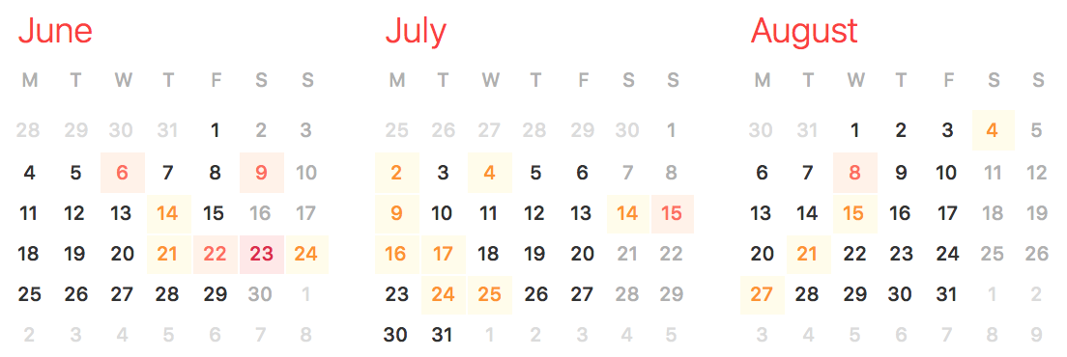
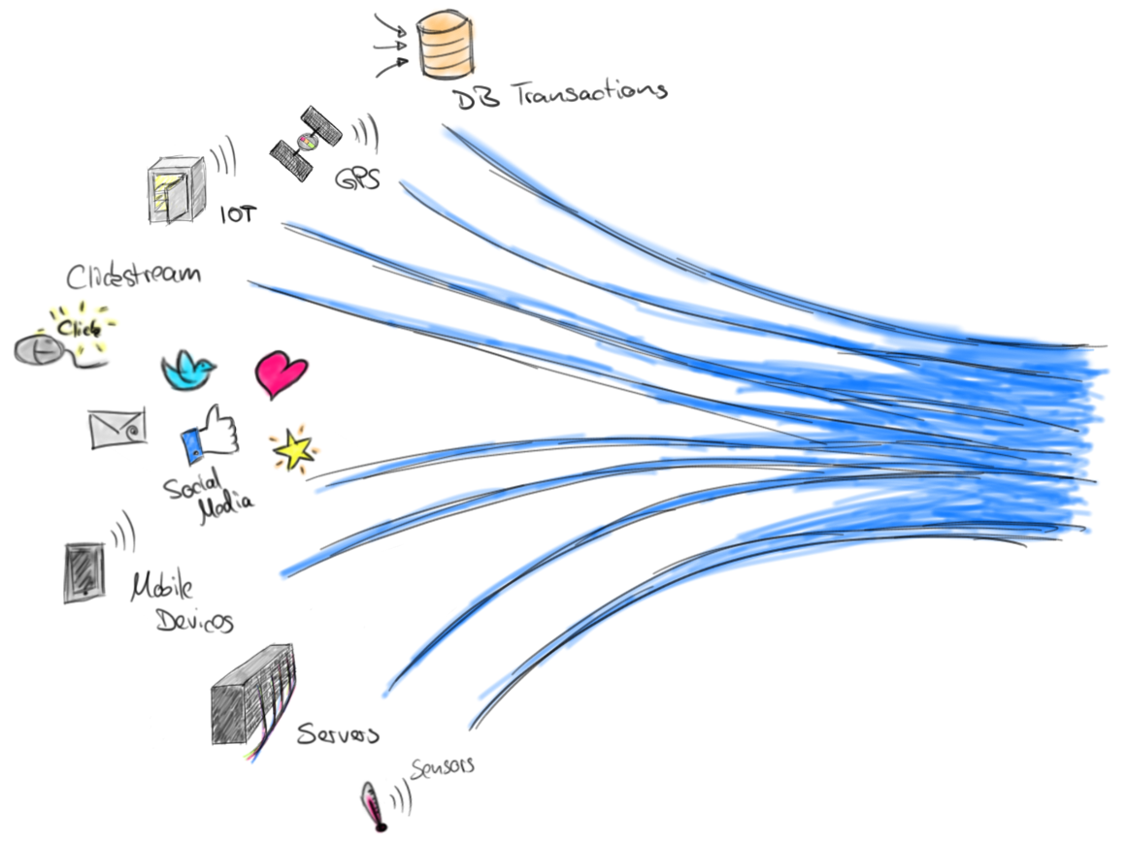

Introduction
1. Scalability
2. Incrementalization
STORE
LOAD
(Schedule)
COMPUTE
STORE
COMPUTE
COMPUTE
Knowledge
Data
Knowledge
Data
Schedule
Reconfigure
STORE
STORE
σθ
Past Data Sets
π
⋈
σθ
⋈
Map
Reduce
Map
Reduce
Map
Reduce
π
σθ
⋈
Past Models
(Past+Present)
Data Streams
σθ

Slide 43
Exactly-once
Exactly-once processing: Operators process elements exactly-once
Exactly-once delivery: Elements are written to sinks exactly once

Slide 44
Apache Flink
Approach: Distributed Snapshots
Contributions
Design
Optimizations
Use-cases (Beyond failure recovery)
Processing guarantees
Performance evaluation

Slide 45
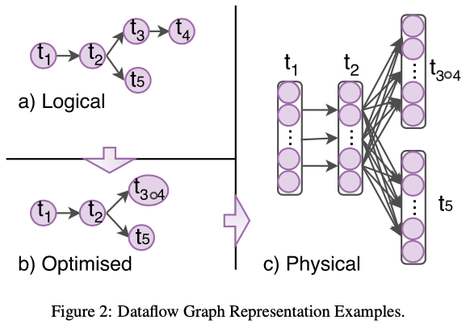
Execution model
Flink has two kinds of state
Operator-State (Task-parallel)
Keyed-State (Data-parallel)
Assigned to key-groups
ListState (append-only)
ValueState (update)
ReduceState (aggregate)
MapState (put/get)

Slide 46
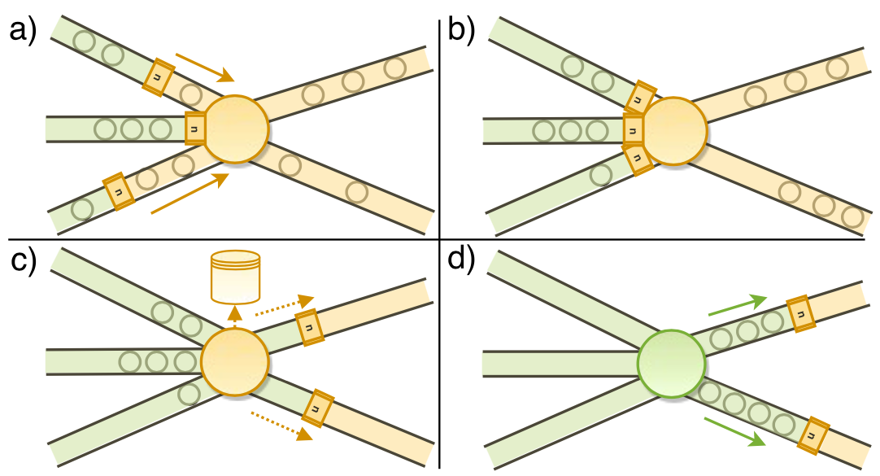

Slide 47
Apache Flink - Assumptions
FIFO ordered channels
Weakly connected graph
Channels can be blocked/unblocked by tasks
Sources are replayable
Src1
M
Task
Sink2
Src2
M

Slide 48
Src1
Task1
M
Task4
Src2
Task2
Task6
Sink1
M
Task5
Src3
Task3
M
Epoch 1

Slide 49
Rollback Recovery
Snapshot
On first marker
Capture internal state
Record other input channels
Forward marker
Finished if no more channels are being recorded
Apache Flink - Assumptions
FIFO ordered channels
Weakly connected graph
Channels can be blocked/unblocked by tasks
Sources are replayable
On secondary markers
Stop recording the receiving input channel
Finished if no more channels are being recorded
Finished!
M
M
S2
M
M
S1
Recording
Recording
M
M
S4
S3

Slide 50
Kafka
Consumer
keyBy
filter
window
aggregate
flatMap
Kafka
Producer
a) Logical
Kafka
Consumer
keyBy
filter
window
aggregate
flatmap
Kafka
Producer
b) Optimised
[1]
[1]
[1]
[1]
message queues
Kafka
Consumer
filter
window
aggregate
flatmap
Kafka
Producer
message queues
offsets
count
window
offsets
… …
… …
… …
… …
c) Physical
Task
Execution
[n]
[n]
[n]
window
aggregate
flatmap
[n]
Kafka
Consumer
filter
Kafka
Producer
offsets
count
window
offsets
Slide borrowed from Paris Carbone, LADIS 2018, Asynchronous Epoch Commits

Slide 51

Introduction
Knowledge
Data
Decision Making
Sensor events
Video
Social media interactions
Transactions
Audio
...
Autonomous driving
Cyber defence
Intelligent assistants
Weather forecasts
...
Analytics
Notes:
For anyone not familiar, stream processing is a paradigm for implementing analytical applications on "real-time data". Data

Slide 52
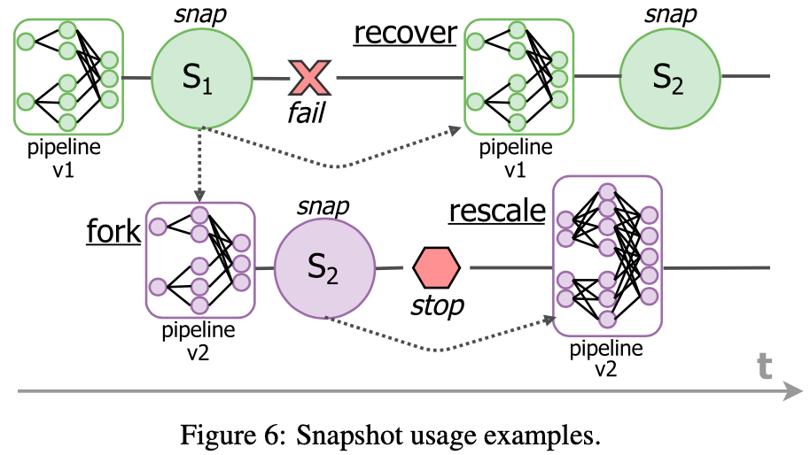
Snapshot Use-cases
Rollback recovery (Partial)
Rescaling (Full)
Restart from beginning of latest epoch

Slide 53
Snapshotting Attributes
Modular state backend:
Local:
In-memory or out-of-core, RocksDB
External: DBMS
MVCC-enabled (Multi-Version Concurrency Control): Keep multiple versions
Non-MVCC: Write-Ahead-Log
Ad-hoc queries: Flink's uncommitted state can be read (key-val) from external systems
Async compactions
Lazy materialization (Log-structured merge)

Slide 54
Exactly-once Delivery
Idemptotent sinks + Deterministic streams
Transactional sinks:
WAL + 2-phase commit
Eagerly append uncommitted changes

Slide 55
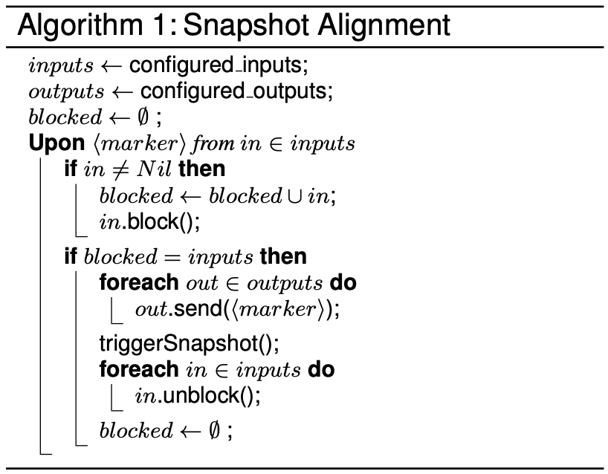
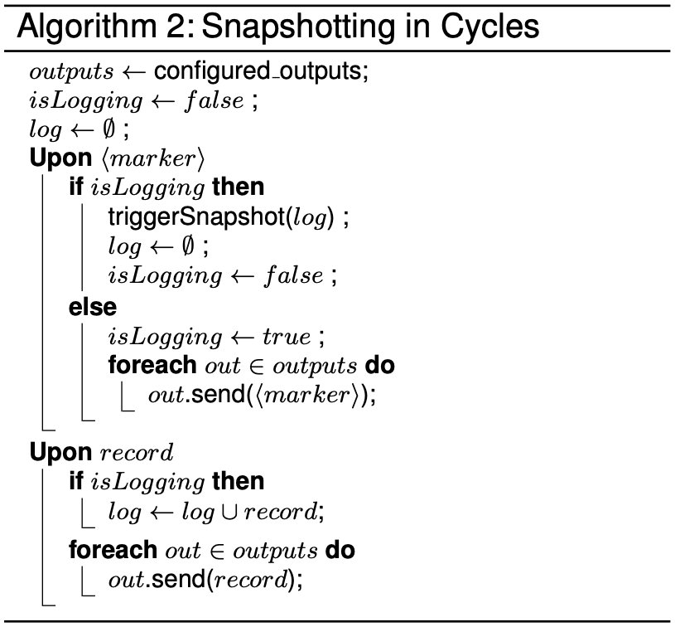
Algorithms

Slide 56
BIN

Slide 57
Incremental query model
Easy to integrate with external systems
Exactly-once transactional model
Hybrid batch / streaming API
Re-use SQL engine, optimizer, and code generator
Write-ahead event log (manual/automatic recompute)

Slide 58
Requirements
Input sources must be replayable
Output sinks must support idempotent writes

Slide 59
State
Write-ahead-log keeps track of data written to output sinks
State store holds state snapshots for long-running aggregation operators

Slide 60
Programming Model Semantics
Each input source provides a partially ordered set of records over time
The user provides a query to execute across the input data that can output a result table at any given point in processing time
Triggers tell the system when to run a new incremental compu- tation and update the result table
The sink’s output mode specifies how the result table is written to the output system (Complete / Append / Update)
=> Prefix consistency

Slide 61
Operators
Watermarking operators tell when to close an event time window
Stateful operators are UDFs with state (map & flatMap)

Slide 62
Query Planning
Analysis - Check types, attributes, possibility of incremental execution, output mode
Append => Monotonic
Incrementalization - Incrementalize queries, ensuring that results can be updated in time proportional to the amount of new data received before each trigger
Optimization -
Predicate pushdown, projection pushdown, simplification
Tungsten binary format to avoid Java object overhead
Java bytecode code generator

Slide 63
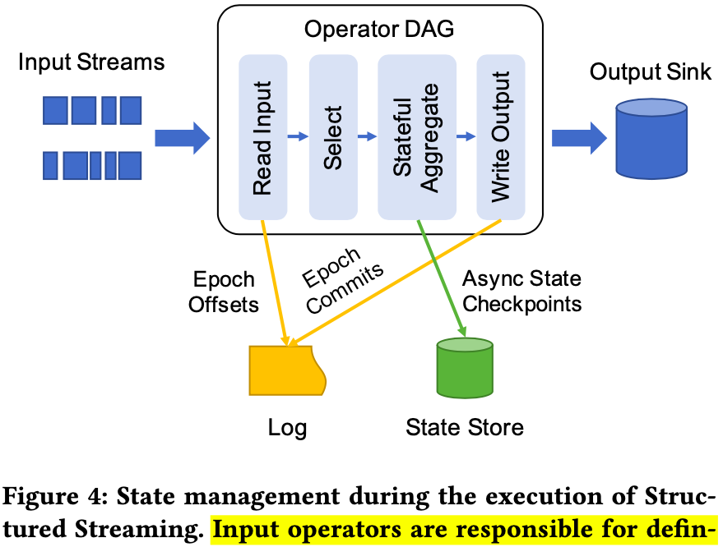
Execution
Microbatch mode - Discretized Streams (Launching DAG gives higher latency)
Dynamic load balancing
Fine grained fault-recovery
Straggler mitigation (Backup)
Rescaling
Scale and throughput
Continuous processing
Does not prevent stragglers / load imbalance
Adaptive batching & Run-once triggers

Slide 64
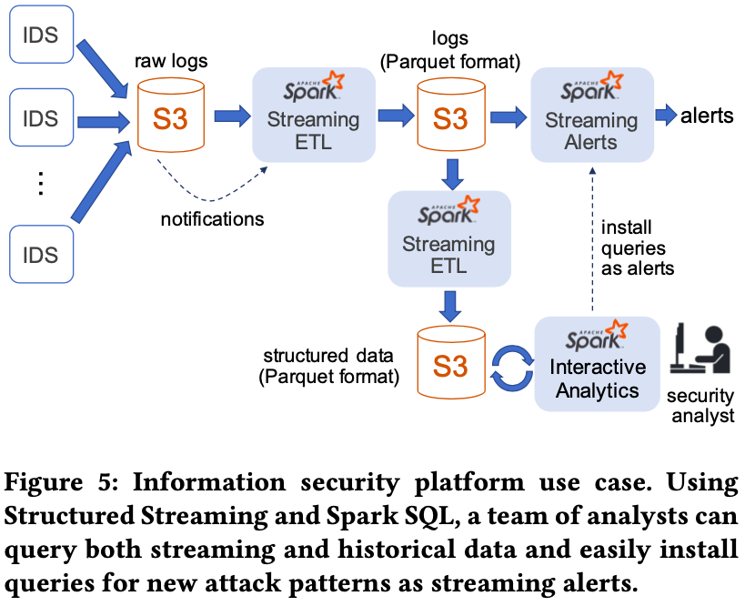

Slide 65
Evaluation
Yahoo! Streaming Benchmark

Slide 66
Contributions
API: Incrementalization (as opposed to flink which Flink passes deltas vs. complete results)
Exectution Engine

Slide 67
IBM Streams
Partial fault tolerance (Not exactly once)
Guaranteed tuple processing (Exactly once)
Consistent region - Subgraph of operators
Non-deterministic, cyclic graphs, multi-threaded operators
Problems of distributed snapshots:
Performance impact
Code complexity
Existing framework concepts
Ease of adapting legacy applications
Contributions:
Add a drain stage to the distributed snapshot which reflects channel state as operator state
Language level abstractions for fine-grained control over fault-tolerance guarantees
Runtime APIs for interfacing with the protocol

Slide 68
Algorithm
Based on Chandy Lamport
Algorithm
Drain stage - Starts when all markers are received
Tuples submitted before or during drain stage are processed by downstream operators
Checkpoint stage - Starts when all channels are drained
Resume processing when all operators in a consistent region have checkpointed (notification from consistent region controller)
Reset stage
Failure recovery by retrieving state from a checkpoint backend store
Triggered by a reset marker (from the controller)

Slide 69
Stream Processing Language (SPL)
Primitive operators (C++ w/ codegen, Java, SPL)
Composite operators (Subgraphs of operators)
Operators can have multiple input/output ports
Input ports can have multiple input stream connections
Data ports / control ports, feedback loops / Processing elements (Processes), optionally threads
Annotations:
@consistent - Start operators replay on failure
@autonomous (default) - Sources do not replay on failure, at-most-once when in upstream of @consistent, may receive duplicates when in downstream
All reachable operators are considered to have the same annotation, @consistent takes precedence

Slide 70
Consistent operators block connections from autonomous during snapshotting
If there are consistent control ports, then just forward marker and no checkpoint stage?
Starts when drain stage completes and markers are processed from consistent control ports
No drain markers are expected from A-ports
Start checkpointing when markers are received on all ports
Protocol ends when all operators have drained & checkpointed (detected by consistent region controller)
Indicate completion by invoking method in consistent region controller service
Transactions (Runtime cannot checkpoint/reset while operators are submitting tuples)

Slide 71
PEs
Channels
Ports
Consistent regions
Consistent region controller (one per region)
Job control plane

Slide 72
Custom operators with callbacks (can be multithreaded)

Slide 73
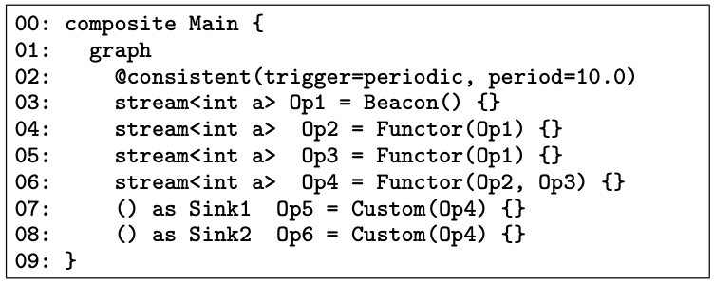
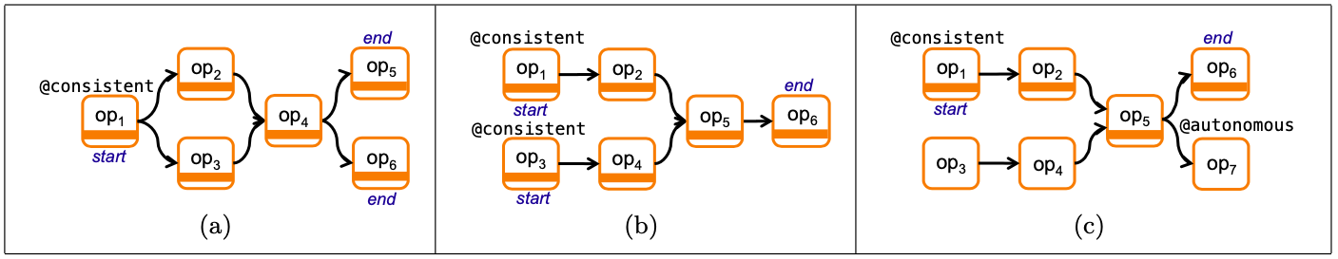
Consistent Region
Figure 1: Example definitions of a consistent region.
Figure 2: Sample SPL program equivalent to the application graph in Figure 1(a).

Slide 74
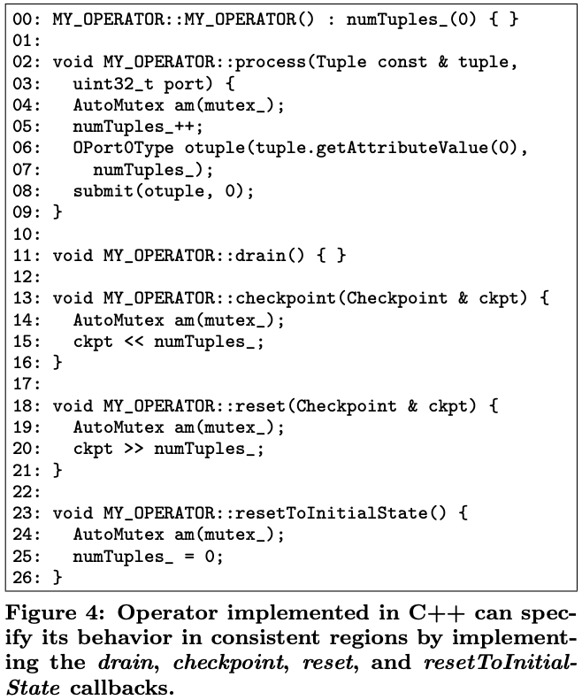
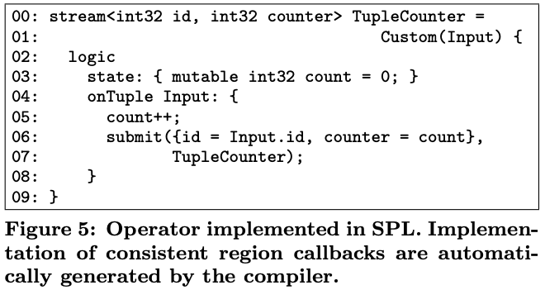

Slide 75
PE
C
PE
PE
C
C
C
PE
A
Crashes & Disconnects

Slide 76
Conclusions & Predictions
Streaming as a service
Persistent channels / RDMA / NVME

Slide 77
Predictions
Past
Present
Future
In-house
Data center
Cloud platforms
Edge devices
"
"
Buy your own hardware
Secure but hard to maintain
Dedicated cloud platforms
Microservices
"Internet of things"
Planet-wide scale-out

Slide 78
Local filters
Exposing state for queries outside
Cloud + Edge combined, dynamic scheduling & elasticity
Stream processing is taking over use-cases of in-memory databases
Functions as a service
Stream processing will take over databases to some extent

Slide 79
Faster recovery on edge!!
Bigger graphs

